Slide 1
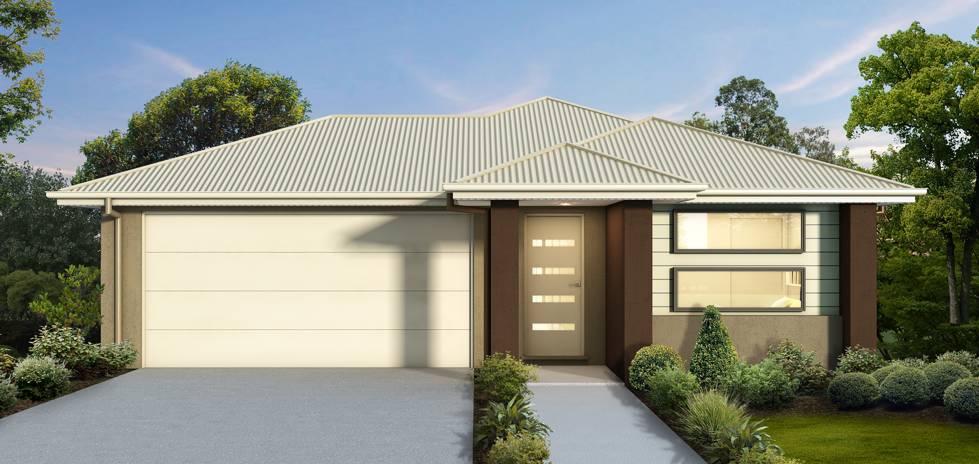
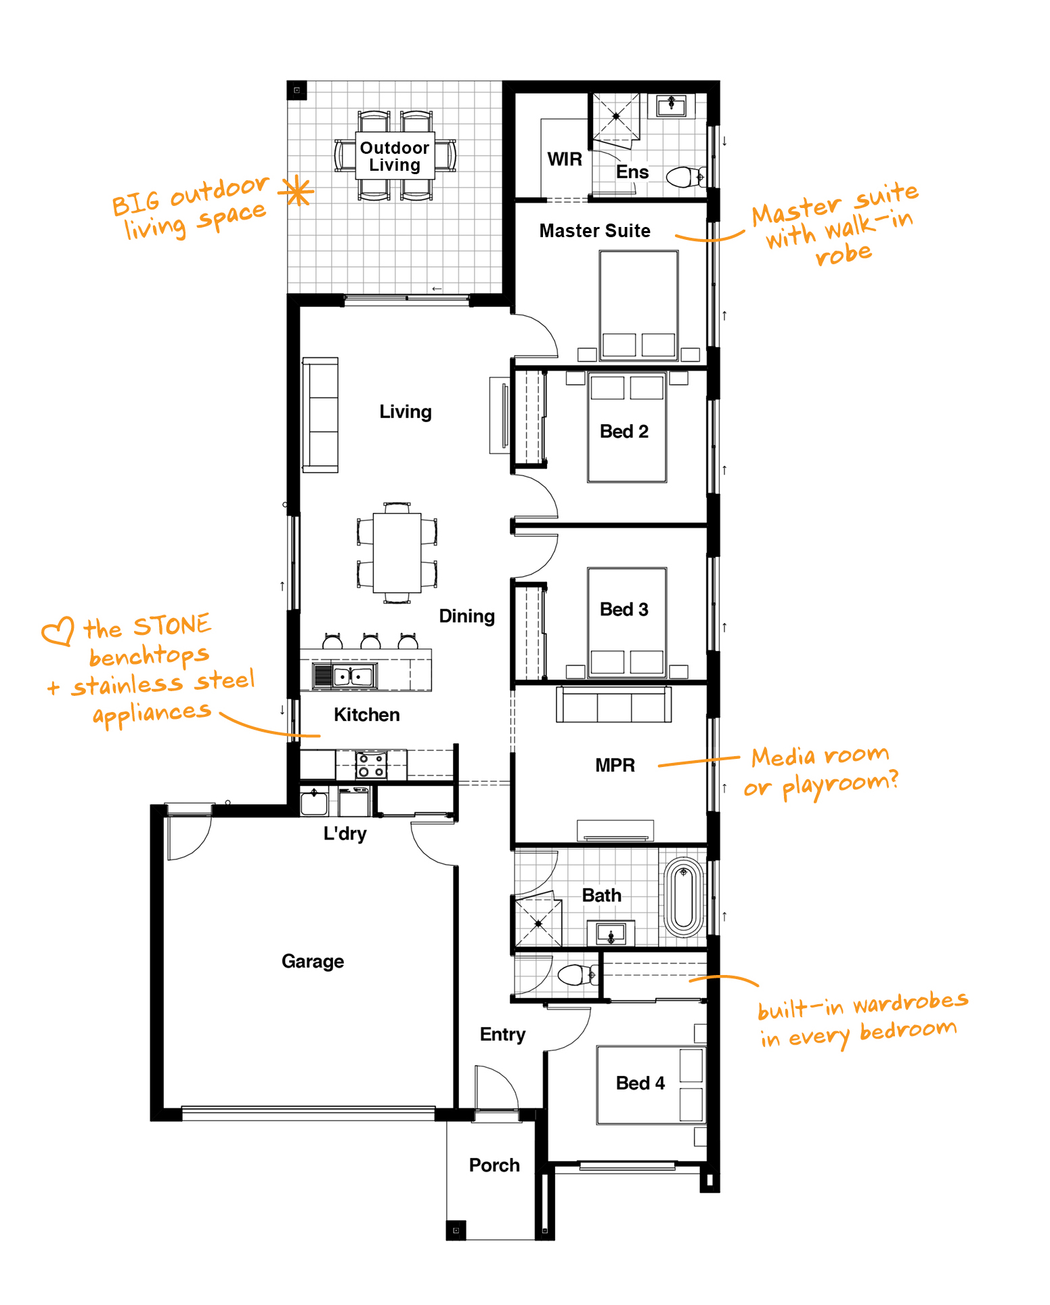
Morayfield Landing
4
2
2
2
183m²
400m²
$479,200
Lot 214 Einasleigh Street, Morayfield
Nova 19
Modern
Steel frame and trusses
20mm Caesarstone Kitchen Benchtops
600mm Stainless Steel Kitchen Appliances
Flyscreens, blinds and ceiling fans
100mm LED downlights throughout
Ceramic floor tiles to entry and living
Quality carpet to bedrooms
3 coat paint system using Taubmans Endure
Tiled Porch & Alfresco
NBN ready
H1 Concrete Slab
Exposed Aggregate Driveway
Letterbox &Clothesline
And much more!
Contact Claudia on 0429 800 151 or email Claudia@drhomes.com.au
Please note: Pricing is current as at 31/08/2020 and based on a land value of $210,000. This is a proposed house and land package that is yet to be constructed and is subject to site inspection, soil and contour reports & council approvals. Other house designs, facades and lots may be available. House and land will need to be purchased separately. Floor plan is illustrative and indicative only. Furniture shown is not included. Conditions apply to all promotions. For detailed package pricing and full list of inclusions please speak to one of our Home Coaches or contact sales@drhomes.com.au. © 2020 All Rights Reserved. DRHomes Pty Ltd. QBCC Licence No. 1165013

